Slide 1


Introduction to IDE and HTML
By: Abhishek Mankuskar ⚡

Slide 2
01.
What is an IDE

Slide 3
IDE (Integrated Development Enviornment)
Software that Provides all the tools Under one platform
⚡ Source Code Editor
⚡ Compiler
⚡ Debugger

Slide 4
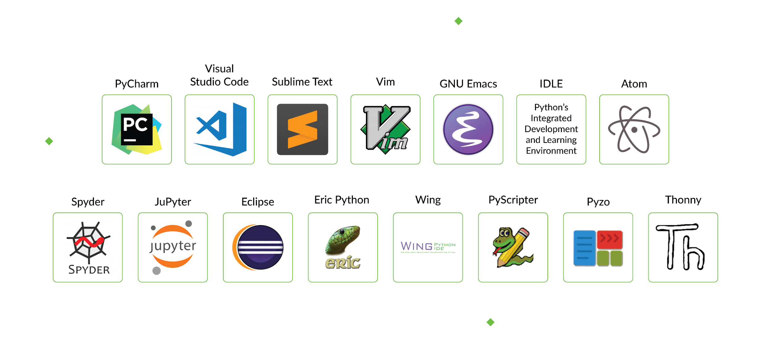
Some Famous IDE’s
⚡ Eclipse
⚡Android Studio
⚡Visual Studio (VS Code)
⚡Net beans
⚡Sublime text
⚡X Code
⚡Atom

Slide 5
01.
Introduction to HTML

Slide 6
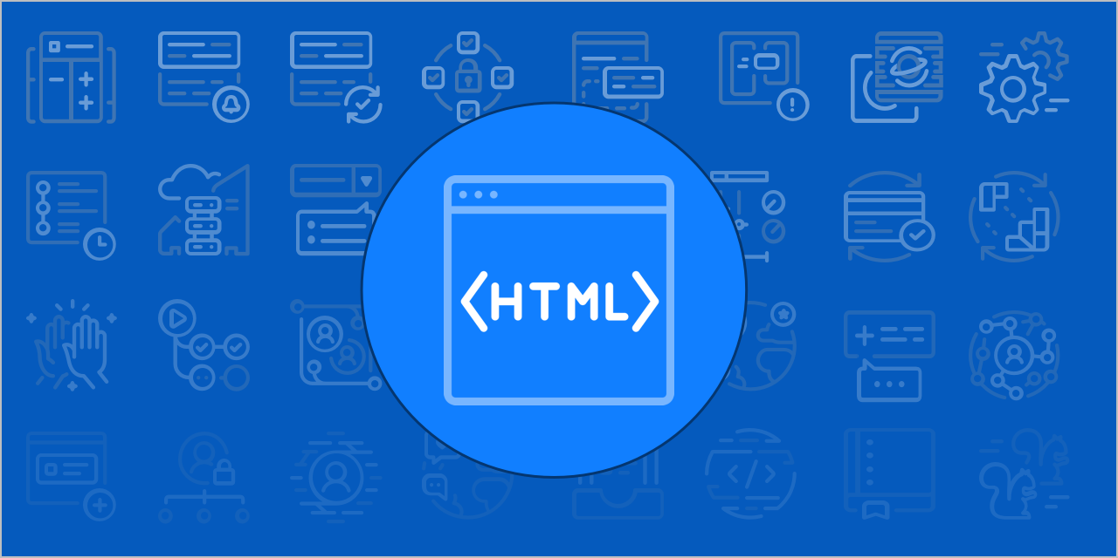
It’s a markup language not programming language.
It Specifies the appearance of web page.
It’s easy to Learn.
HTML (Hyper Text Markup Language)

Slide 7
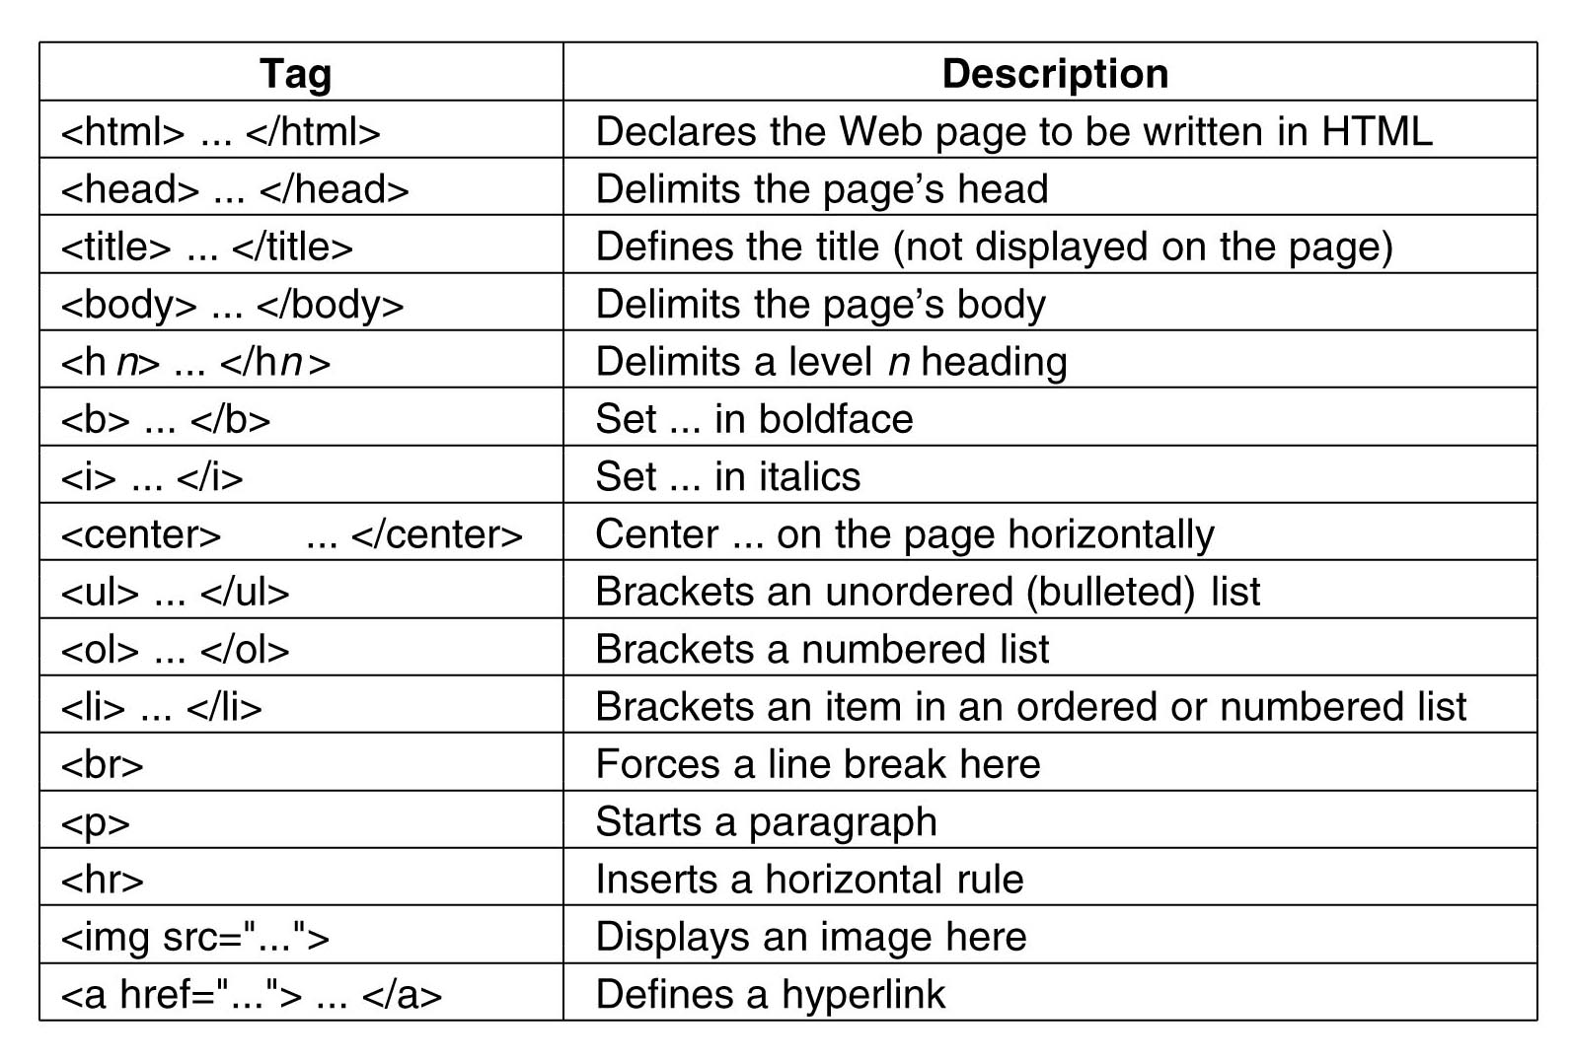
HTML Tags

Slide 8

Endpoint

